Slide 1
Are data breaches an inevitability?
And how do we minimise the risks?

Slide 2
Why Do Data Breaches Happen?

Slide 3
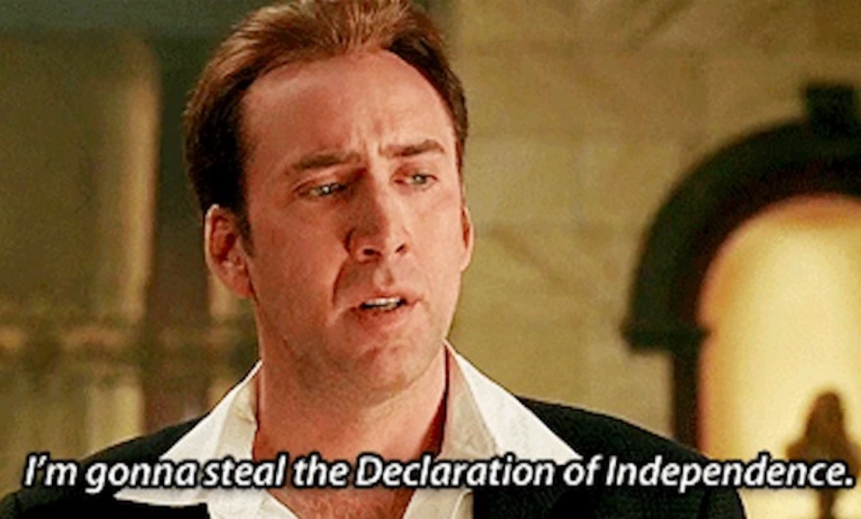

Why might your data be leaked?
Internal issues
External issues
Employee data theft
Employee data leak
Malicious OR accidental
Theft or loss of devices
Human error
“Bad actors”
Cyber attacks
Personally Identifiable Information (PII) is a key target of external attackers.

Slide 4
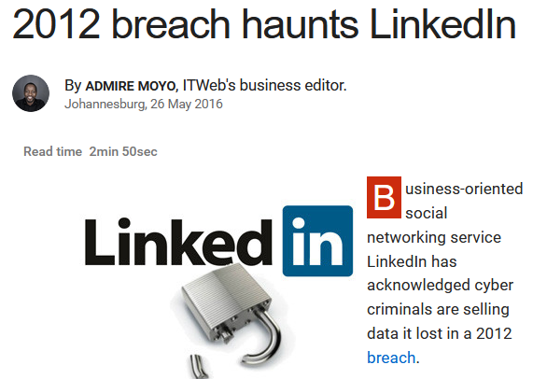
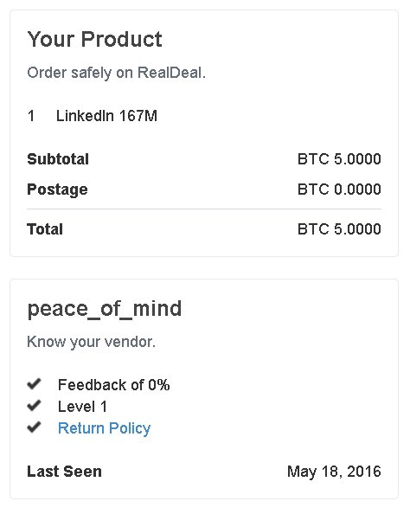
Usernames, passwords, email addresses, and phone numbers are high-value data.
Social networking website LinkedIn was hacked in 2012, by exploiting a database vulnerability.
The LinkedIn database has been sold online to anyone willing to pay 5 BTC (~2,200 USD in 2012).
Buyers are mainly looking for information that may provide “clues” to entry to more high-value accounts, such as:
Banks
Email
PayPal

Slide 5
Data breaches can be accidental or malicious
17% of breaches result from mistakes or errors.
Mistakes happen.
Without sanity checking, employees may send confidential information to the wrong recipient.
Servers and databases may be misconfigured.
28% of breaches involve business insiders.
Outgoing or dissatisfied employees may deliberately access or sell valuable information.
Electronic devices have value and can be sold.
- Verizon 2018 Data Breach Investigation Report

Slide 6
The Consequences of Data Breaches

Slide 7


What happens to your organisation following a data breach?
Loss of Business
Loss of shares valuation
Lose intellectual property
Lose future business
Loss of Trust
Long-lasting reputational damage
Permanent record on news websites and web searches
Legal Consequences
Regulatory fines (i.e. GDPR)
Legal action
Class action suits
Operational
Tidying up the mess disrupts operations
Complete loss of data can be catastrophic

Slide 8
Solutions to Data Breaches

Slide 9
Points of Attack
Client
DNS Provider
ISPs
Server
ISPs
Client
Your data is only as secure as the weakest link in the chain.
Centralised databases potentially have a lot of links in the chain…

Slide 10

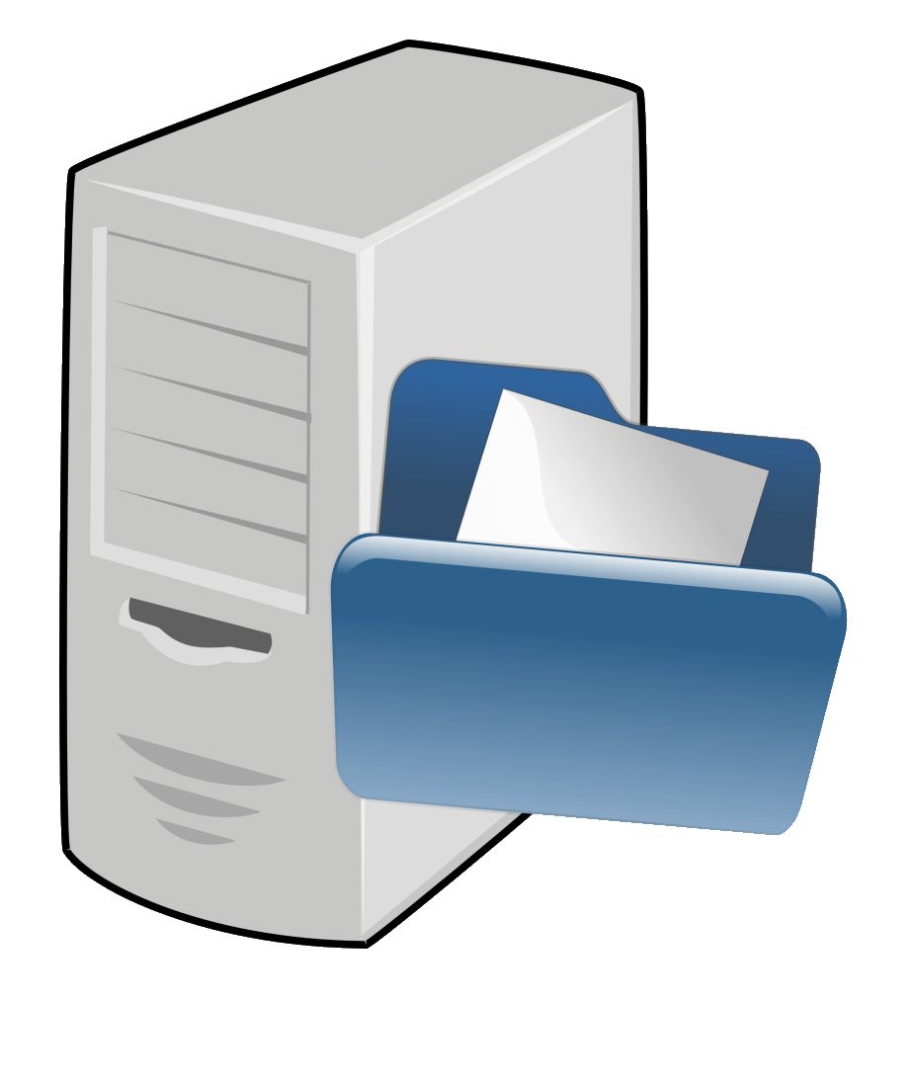

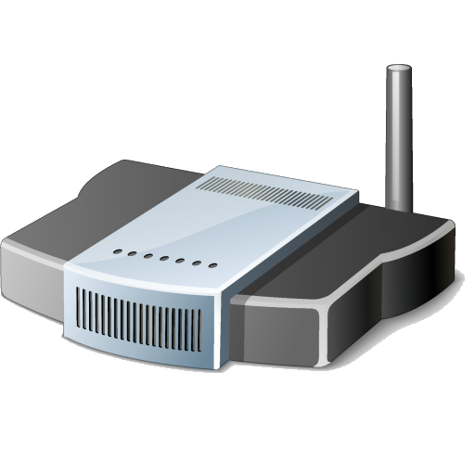

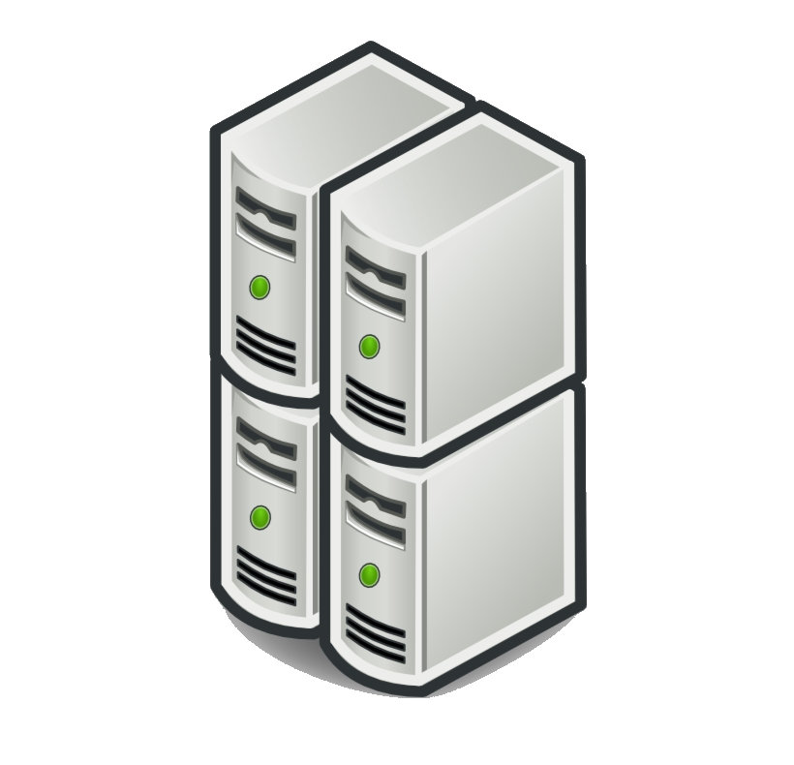
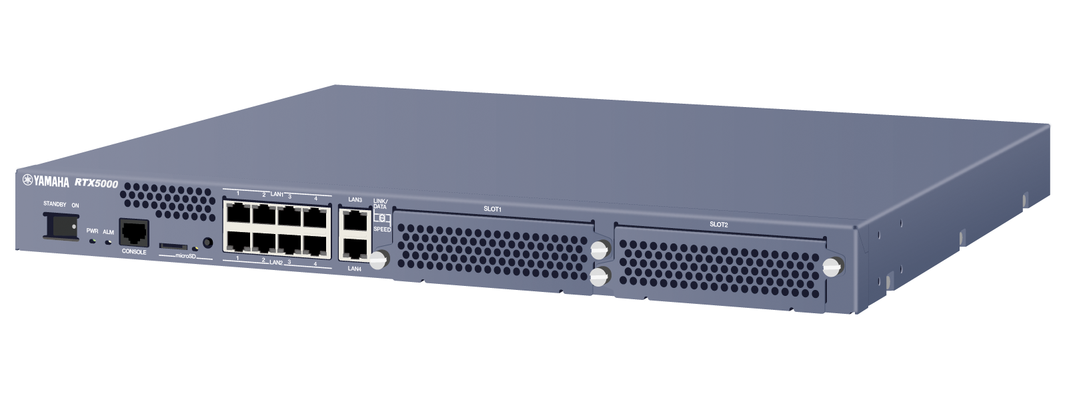
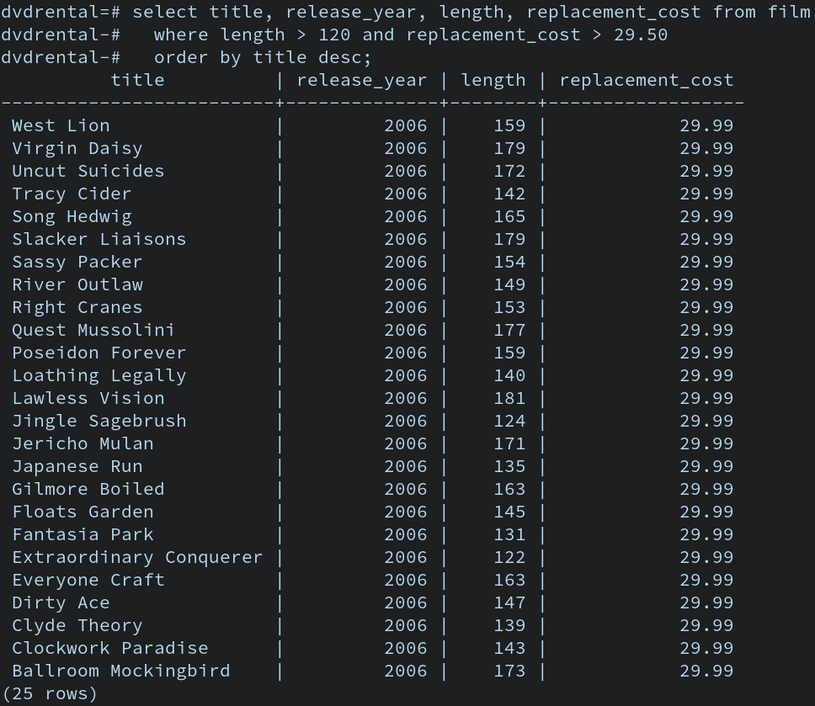
Points of Attack
Hooman
Operating System
Router
DNS Provider
ISPs
Cloud
Router
Stack
Operating System
Database
Your data is only as secure as the weakest link in the chain.
Centralised databases potentially have a lot of links in the chain…
Which we can expand…

Slide 11

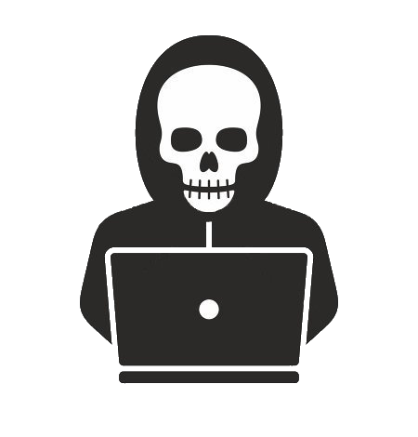



Points of Attack
Hooman
Operating System
Router
DNS Provider
ISPs
Cloud
Router
Stack
Operating System
Database
Your data is only as secure as the weakest link in the chain.
Centralised databases potentially have a lot of links in the chain…
Which we can expand…
And almost every point in the chain can be attacked.

Slide 12
Data can be secured.
Employee Training
Spot, reduce, and mitigate leaks.
Data Governance
Regular checks and administration.
Decentralisation
No central servers severely reduces the risk of total loss of data.
Encryption
Data can only be read if the encryption key is supplied.
Today, it is easy to use “practically unbreakable” encryption.
Free and user-friendly software exists to encrypt your data.
Blockchain
For handlers of incredibly sensitive information only…
Blockchain provides mathematically unbreakable encryption keys.
Visualise every “stopping point” your data makes on its journey from start to end.
Technologies and practices exist to mitigate the risks of data leaking at every point in this journey.

Slide 13
Encryption is powerful
Encryption is a simple, and often neglected, way to secure your data.
Encryption is the second-best way to defend against data leaking, after better organisational practice.
Even in the event of total data loss, so long as the encryption key is not leaked, your data is useless to attackers.
For organisations that deal in incredibly sensitive information, such as governments and banks, blockchain technologies may be the future of creating “mathematically unbreakable” keys.
- Ponemon; 2018 Cost of Data Breach Study, and 2019 Cost of Data Breach Study

Slide 14
Minimise your data footprint
In the brave new world following GDPR (General Data Protection Regulation 2016/679), one of the best ways to mitigate your risk is to not hold data that would make you fall afoul of any legislation.
Personally Identifiable Information (PII) is the high-value target that attackers want to access, and leakers want to sell.
Your end user may use the same email, phone number, and password for your database as they use for their PayPal account.
If your organisation or project has no need for PII, do not store it.

Slide 15
Conclusions
Or, how I learned how to stop worrying, and encrypt my database.

Slide 16
Conclusions
Are data breaches inevitable?
Attackers and leakers have a financial incentive to leak your data.
Especially if you deal in Personally Indentifiable Information (PII).
If you are a small organisation, you can still attract attackers who just want a challenge, rather than a reward.
The risks of data breaches far outweigh the costs of protection.
Can you protect yourself against data breaches?
The most effective defences are the easiest to implement.
Lots of technological solutions exist to protect yourself against data breaches.
Many of them are free and open source.
Data security is an active and well-trodden path. Cybersecurity is always developing!

